Slide 1
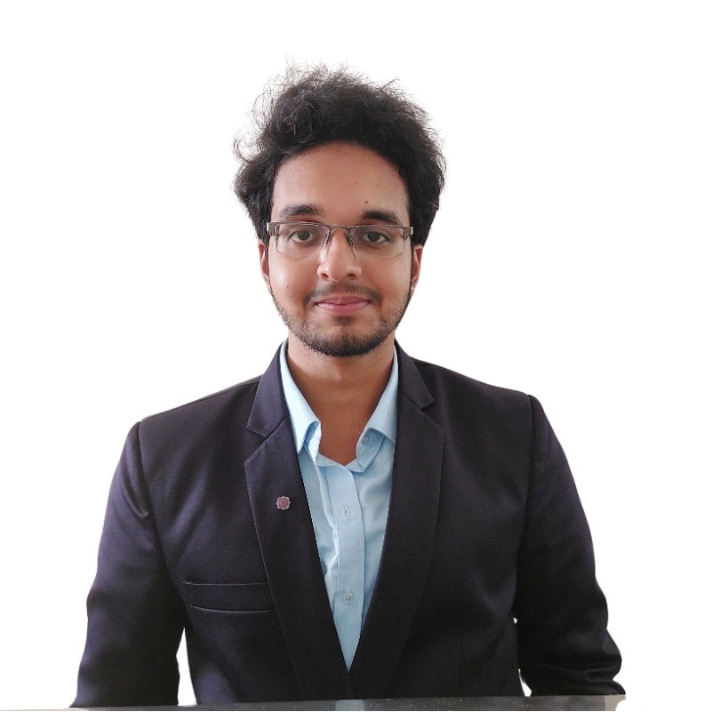



Skills
Allianz Experience
Data Analytics support of Internal Audits
Developed Power BI Dashboards to help Internal Auditors to do Audit tests effectively.
Integrated multiple Data sources to power BI to Create Dashboards according to Data Analytics tests of Audits.
Power BI
Python
Generative AI
Machine Learning
Polamraju Sai Nithin
ASSOCIATE ANALYST (BUSINESS ANALYTICS)
Sai.nithin@allianz.com
Data Analysis
1.7
years
FastAPI
Sai Nithin is a seasoned expert in the field of data science, with a keen interest in machine learning, big data analytics, and dashboard creation. He has completed internships focused on image forgery detection and natural language processing (NLP). Additionally, I independently managed client project tasks, consistently delivering results in a professional manner.
Ask me about: Power BI reporting, Gen-AI , LLM’s , FastAPI , AI Agents , visualizations.
POC
Broker Prioritization POC
Worked on Broker Prioritization model using Cytora Data.
Working on Cytora Data Model to get required important fields which can be used to train Model.
Prompt Engineering
Power Automate
Timesheet Analysis Dashboard
Developed a Dashboard help clients to track whether all Auditors are updating there Timesheet regularly.
Dashboard help clients to get overall view of total time allocated on each Phase of audit and in overall audit.
Dashboard help clients to track Audits which are exceeding the deadline and Number of hours Spend on audits after deadline.
Languages
English
Location: Trivandrum, INDIA
Gen AI POC
Worked on MCP Concept to intergrade it with financial Analyst Agentic model .
Telugu
Hindi

